Slide 1

Delft Software
Days 2015
27th oct 2015
OpenEarth
Data management with OpenEarth DataLabs
Dr.ir. Gerben J de Boer - Van Oord / TU Delft
Dr.ir. Kees den Heijer - Deltares / TU Delft
For code examples see:
https://github.com/openearth/notebooks

Slide 2
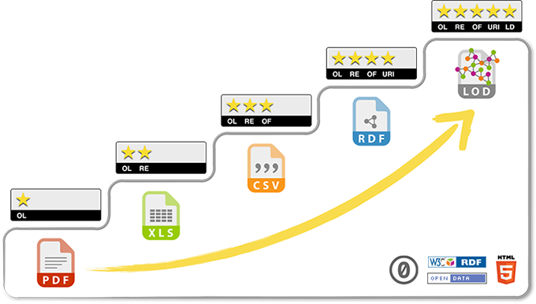
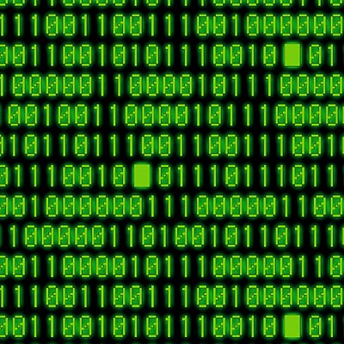
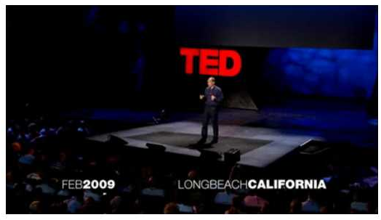
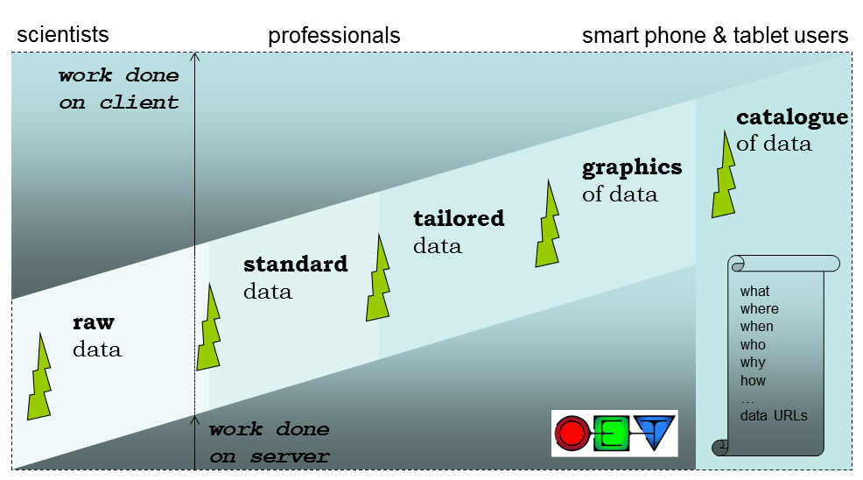
Repository: web-based standards
Different layers of standard inspired by
Tim Berners-Lee: 5 ★
Open Data

Slide 3
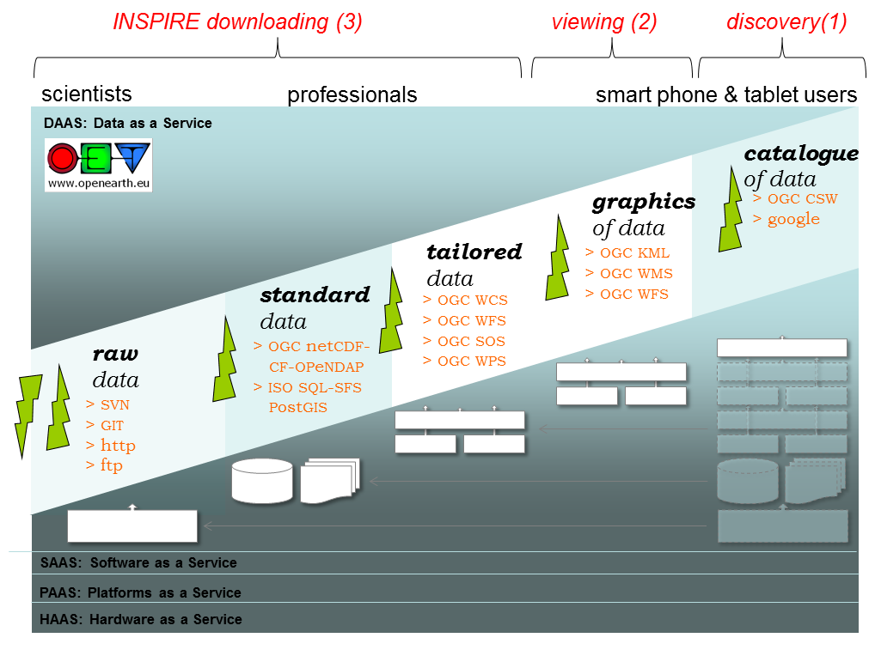
TU Delft PowerPoint

Slide 4
TU Delft PowerPoint
3
2
1

Slide 5
Data discovery
Meta-data portals (human readable)
http://marine.copernicus.eu/
http://oceancolor.gsfc.nasa.gov/
https://www.ghrsst.org/
http://cci.esa.int/
..
Catalogue of THREDDS data server Catalogues
(machine + human readable)
http://opendap.deltares.nl
THREDDS serves data in a variety of formats.

Slide 6
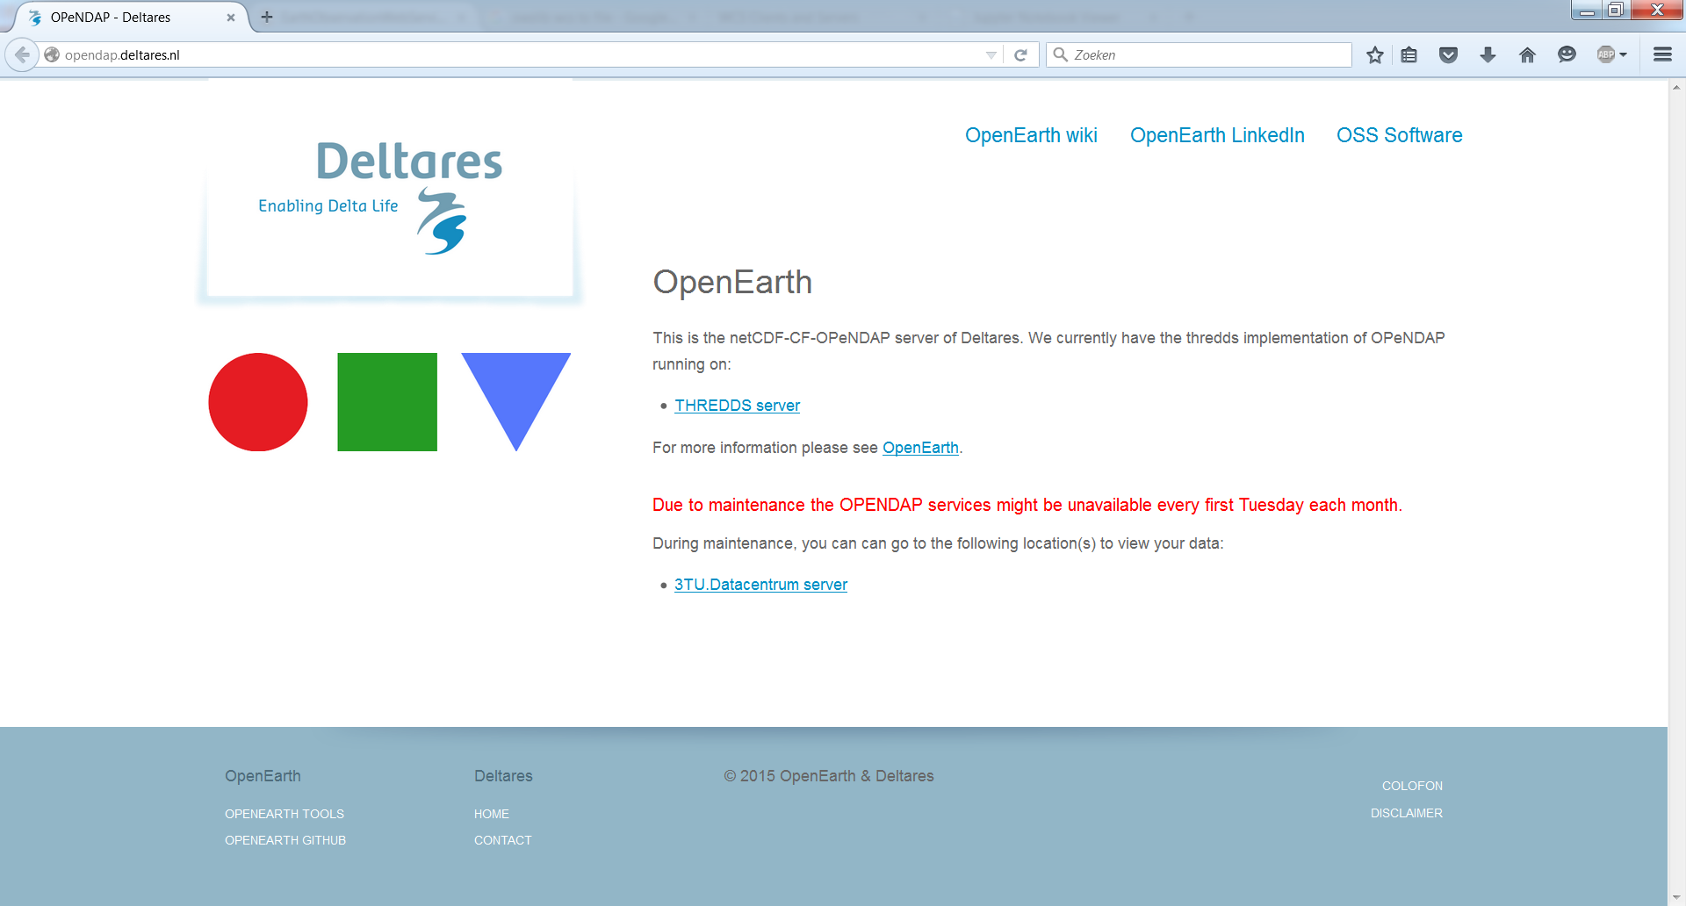
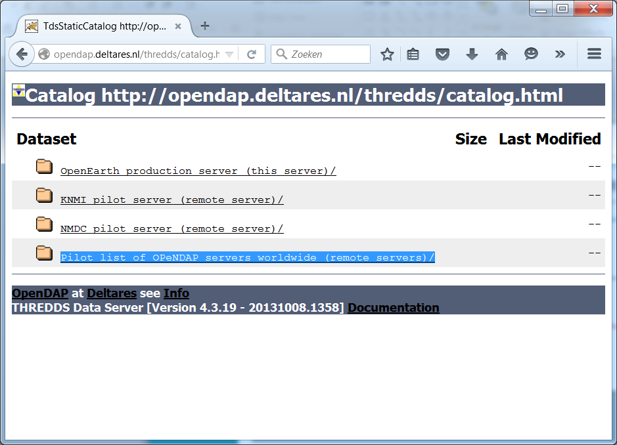
THREDDS opendap.deltares.nl

Slide 7
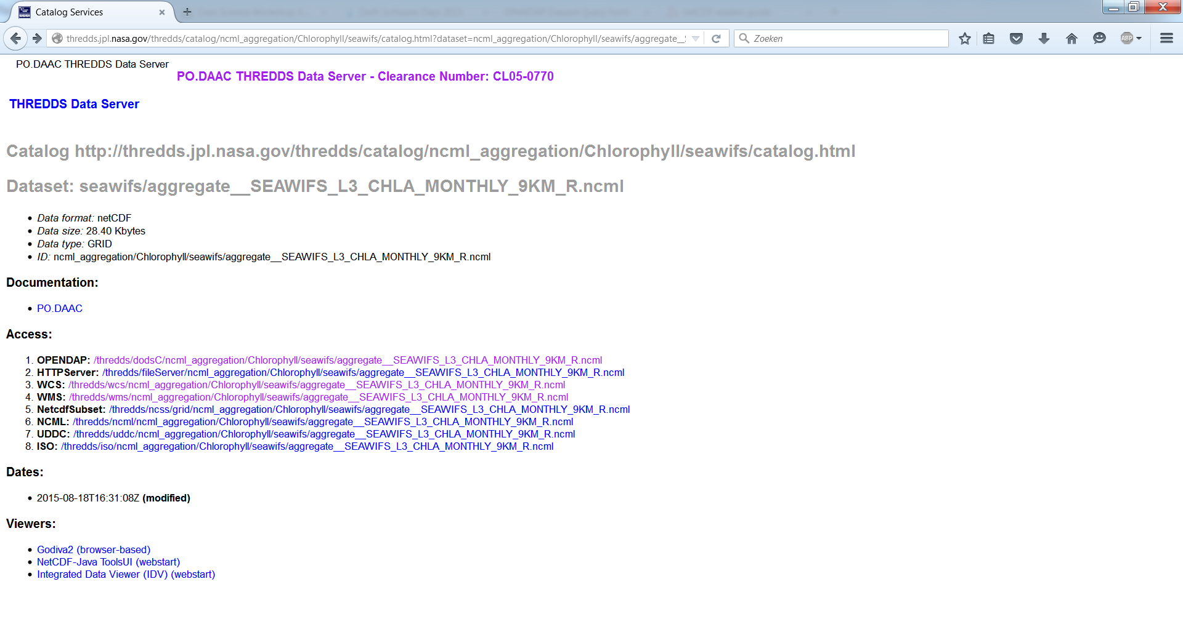
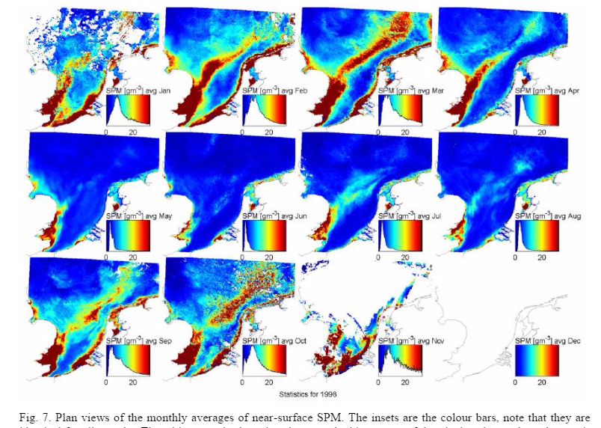
THREDDS data server example
http://thredds.jpl.nasa.gov/thredds/dodsC/ncml_aggregation/Chlorophyll/seawifs/aggregate__SEAWIFS_L3_CHLA_MONTHLY_9KM_R.ncml
I did quite some
SeaWifs analysis myself with SeaDas during my PhD, so it is my favorite example.
Ref: Mechanisms controlling the intra-annual mesoscale variability of SST and SPM in the southern North Sea

Slide 8
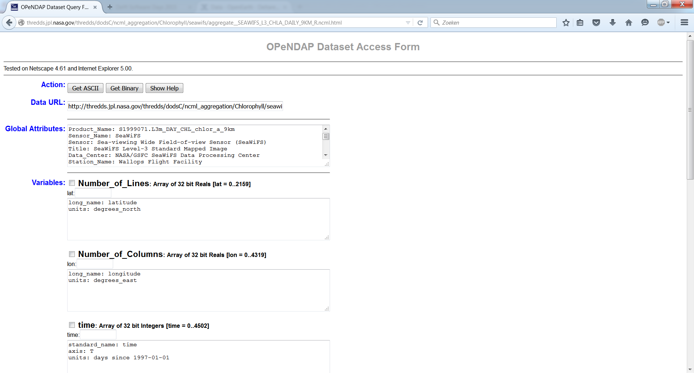
1. OPeNDAP:

Slide 9
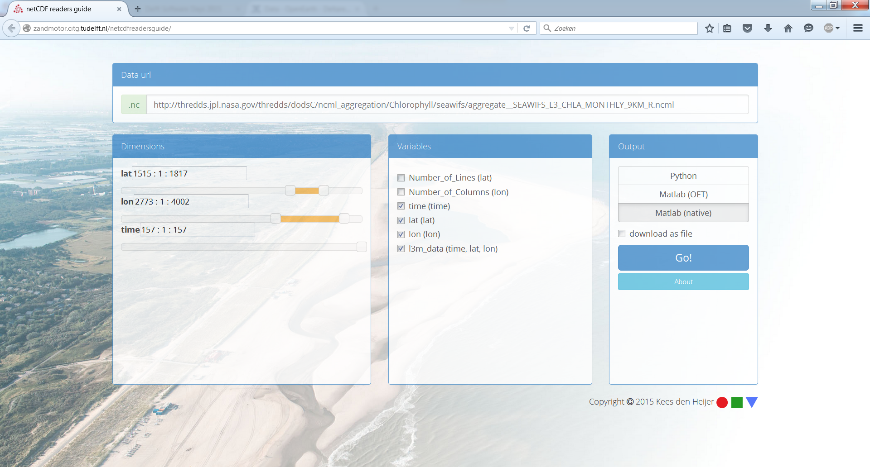
OPeNDAP: with servlet
http://zandmotor.citg.tudelft.nl/netcdfreadersguide/

Slide 10
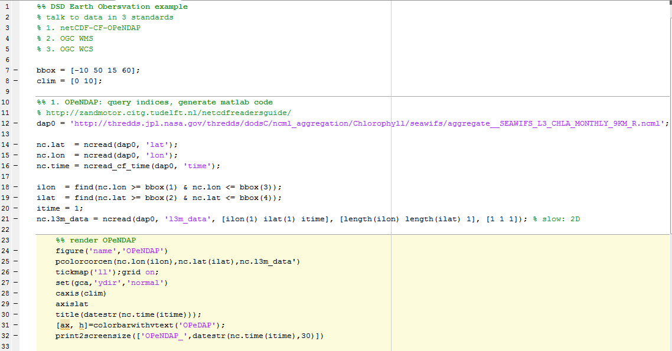
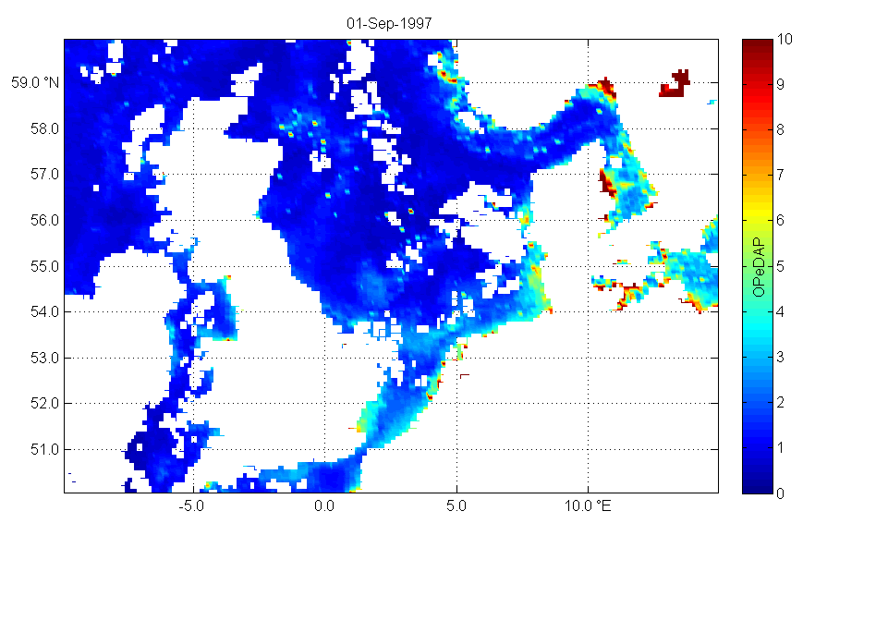
1. OPeNDAP: with Matlab
https://github.com/openearth/notebooks/tree/master/matlab
For netCDF_OPeNDAP you have to get hypercube indices from the geographical bbox yourselves.

Slide 11
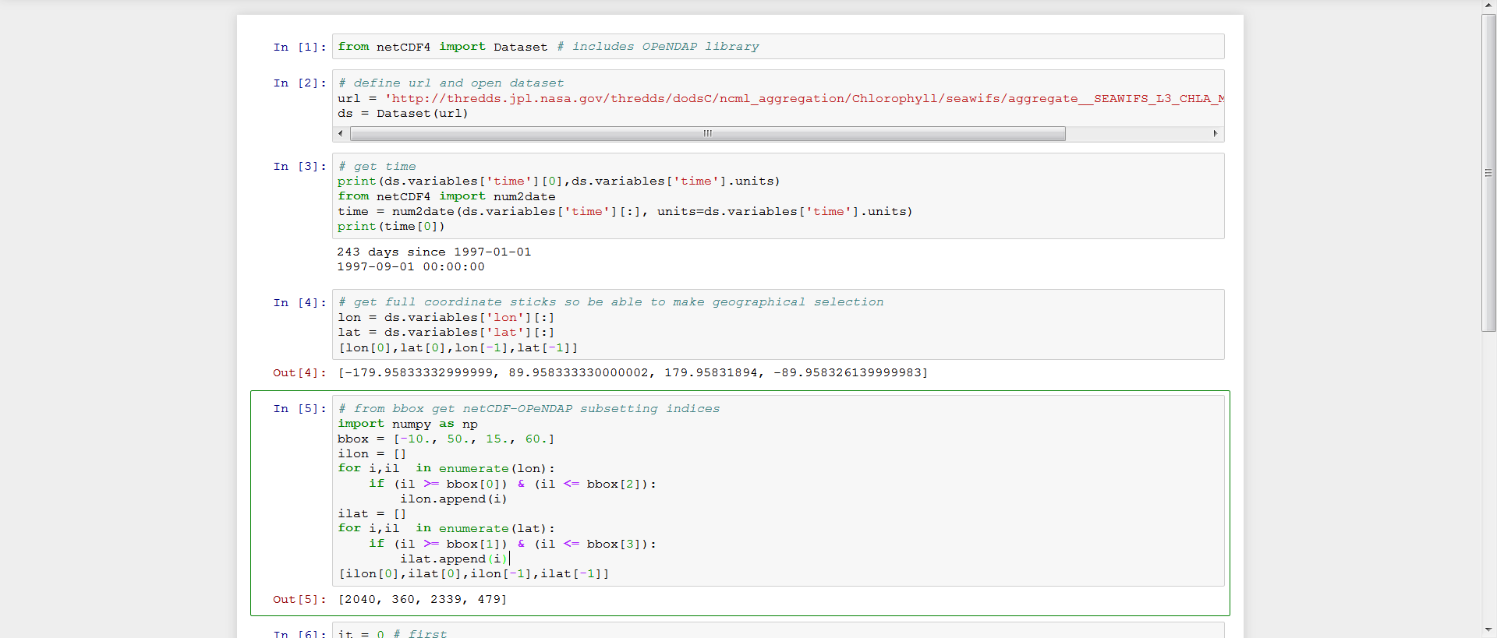
1. OPeNDAP: with Python (1/3)
https://github.com/openearth/notebooks/blob/master/EarthObservationWebServices.ipynb
For netCDF_OPeNDAP you have to get hypercube indices from the geographical bbox yourselves.

Slide 12
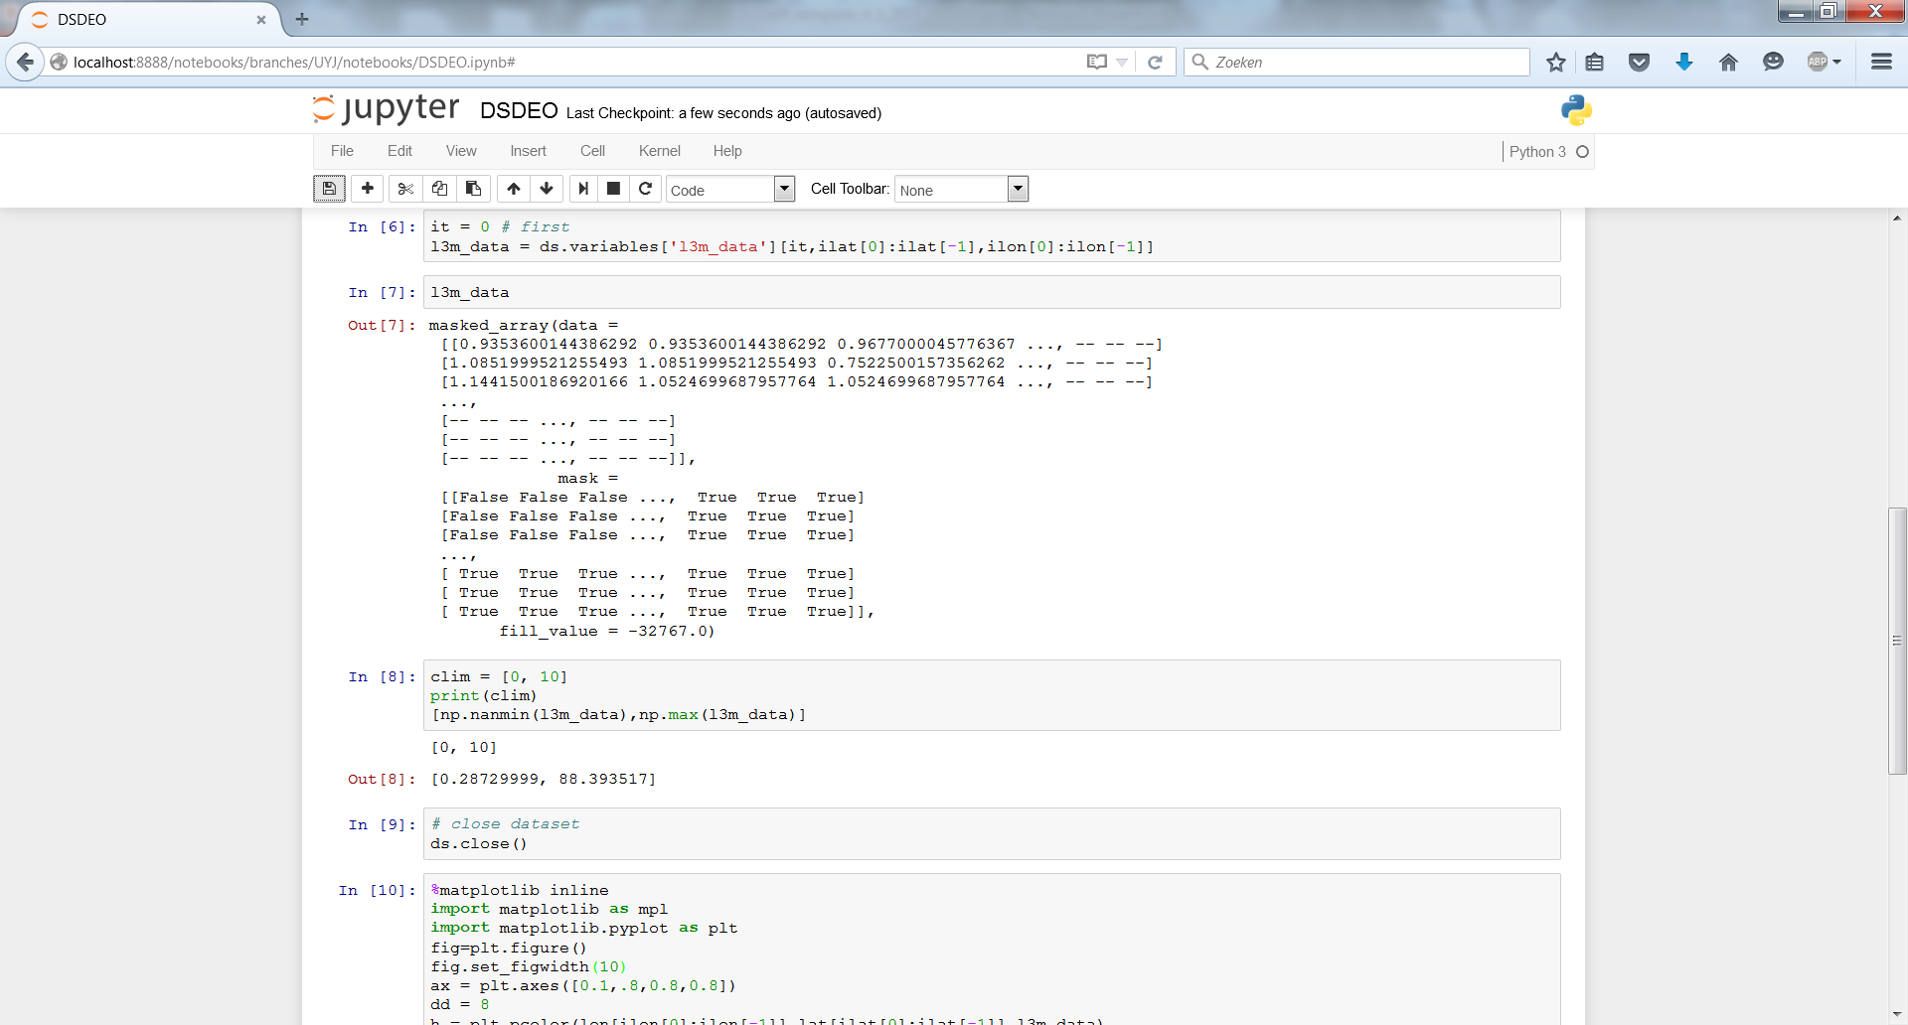
1. OPeNDAP: with Python (2/3)

Slide 13
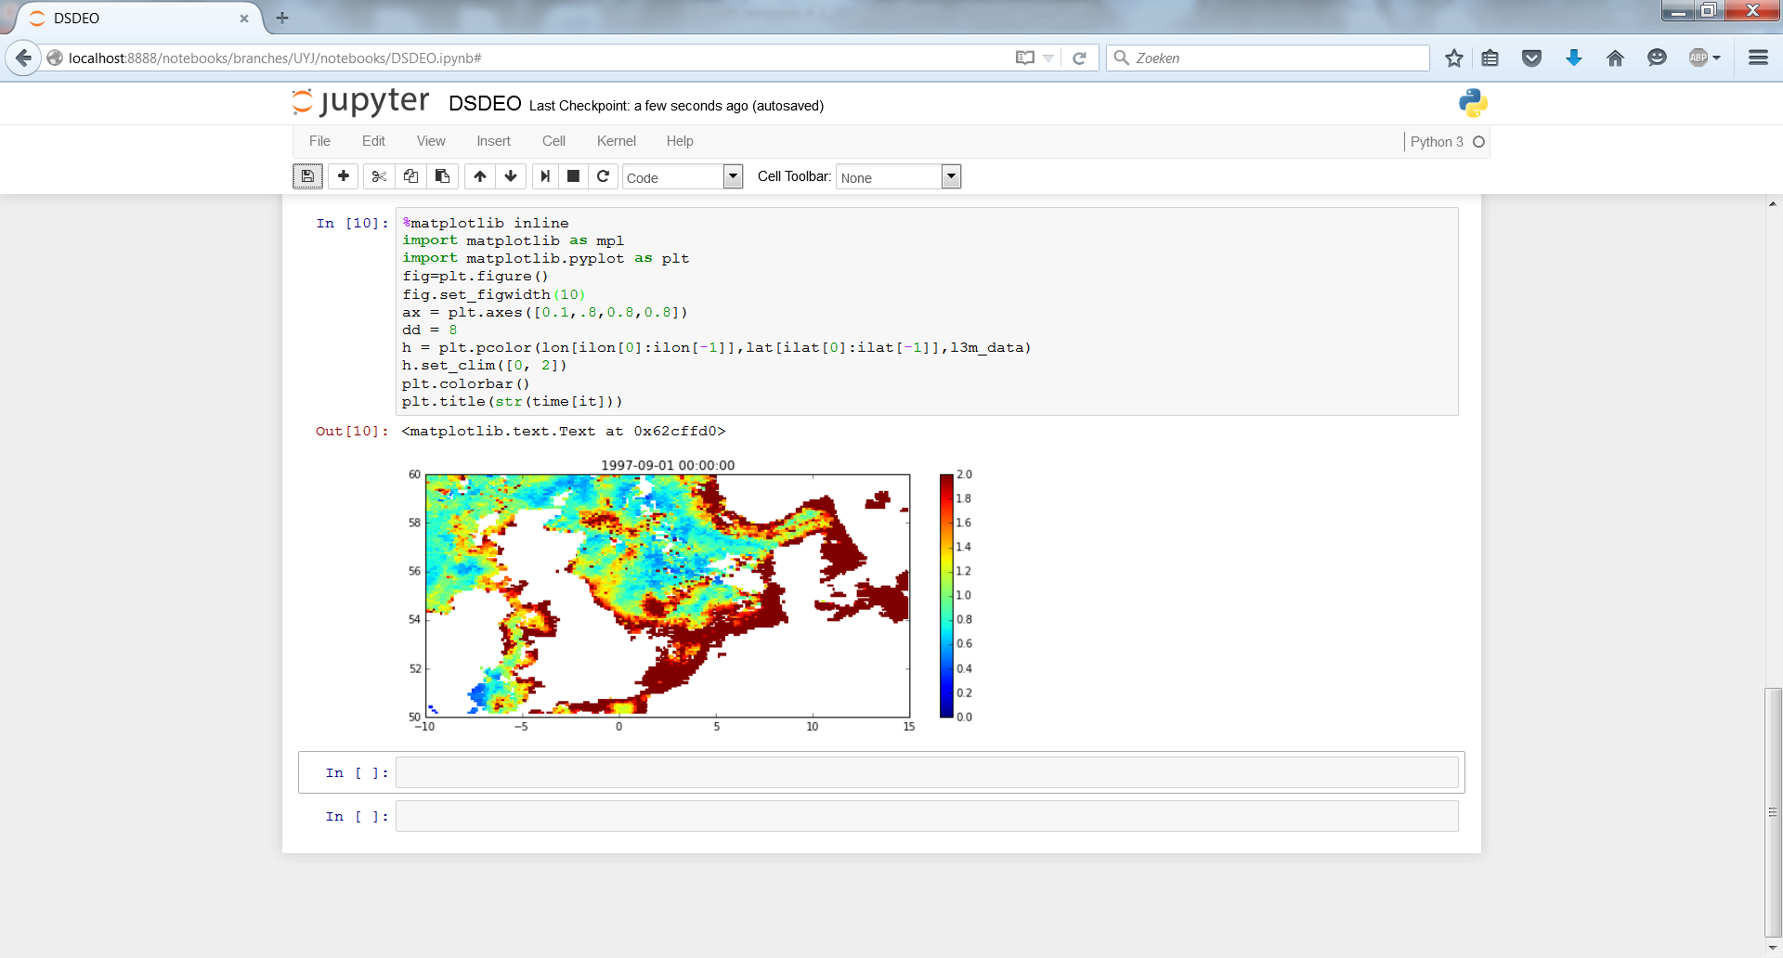
1. OPeNDAP: with Python (3/3)

Slide 14
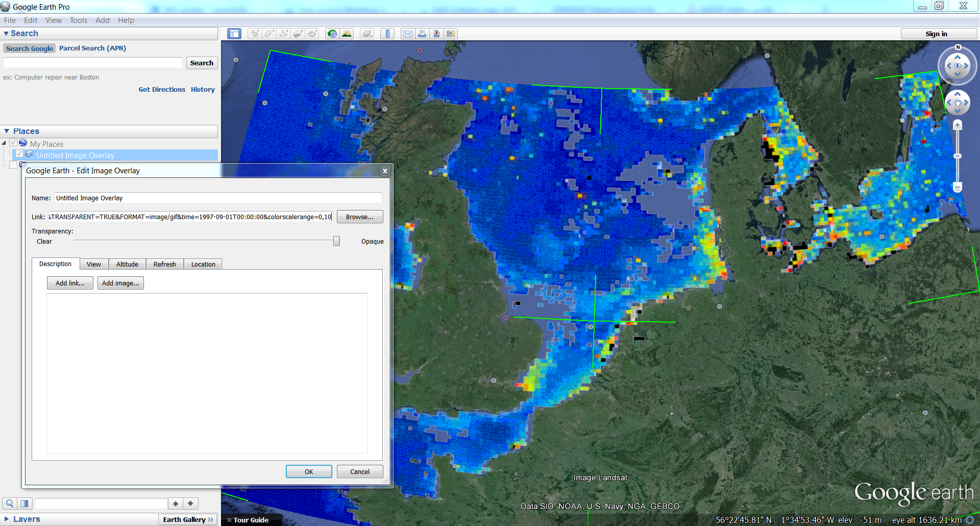
2. WMS: with Google Earth
Hard-code non-OGC keywords like time, colorscalerange. Because Google preserves them. Do not hard-code bbox.

Slide 15
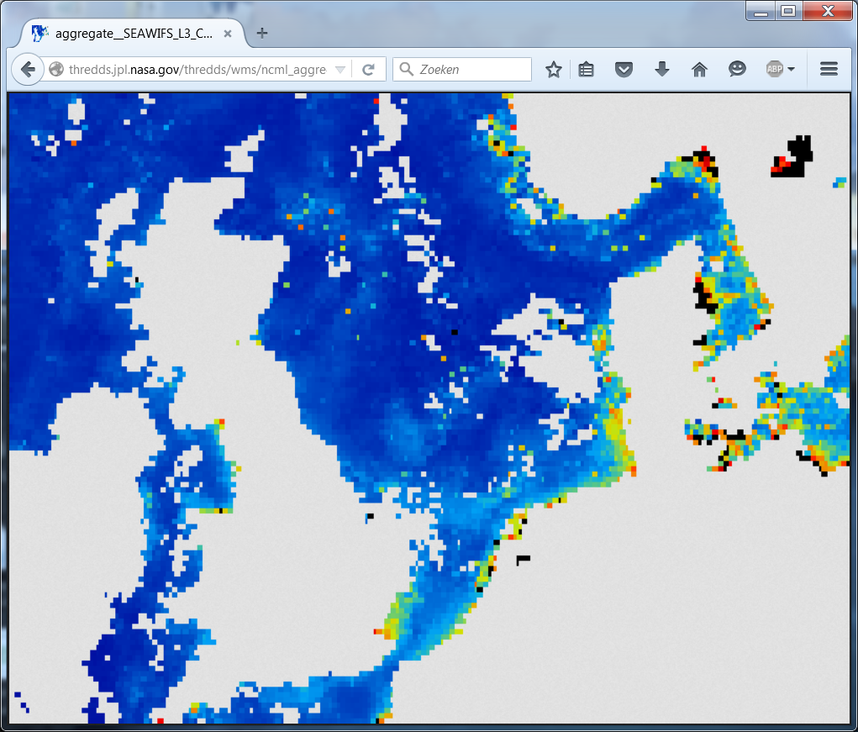
2. WMS: with browser
https://publicwiki.deltares.nl/display/OET/WMS+primer
http://thredds.jpl.nasa.gov/thredds/wms/ncml_aggregation/Chlorophyll/seawifs/aggregate__SEAWIFS_L3_CHLA_MONTHLY_9KM_R.ncml?
&service=WMS&
version=1.3.0
&request=GetMap
&bbox=50,-10,60,15
&layers=l3m_data
&format=image/png
&CRS=EPSG%3A4326
&width=800
&height=600
&transparent=true
&styles=boxfill/sst_36
&colorscalerange=0,10
&time=1997-09-01T00:00:00.000Z
You can paste this block into your browser incl. the end-of-line characters.
Last 2 are non-OGC.

Slide 16
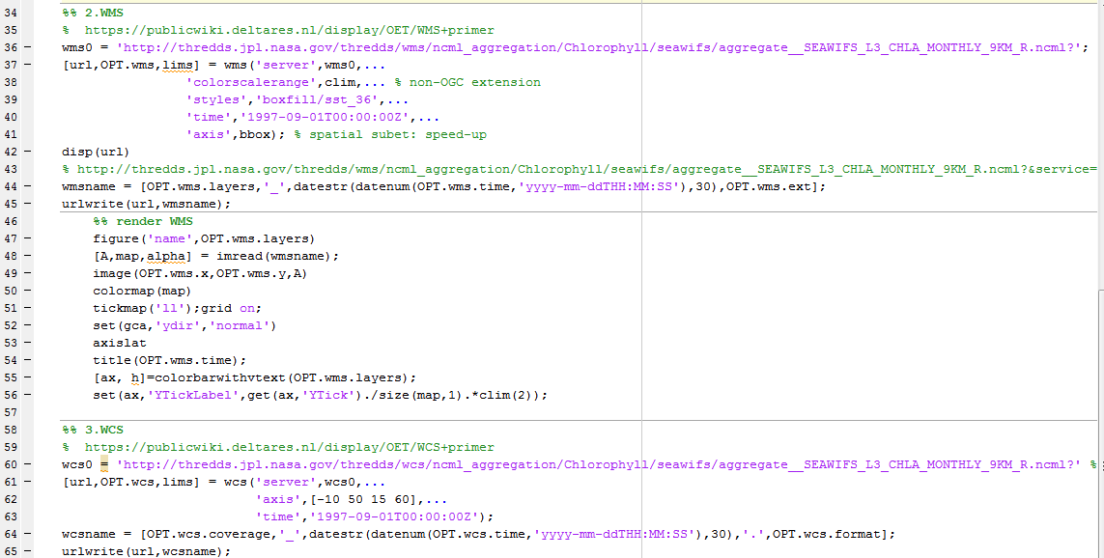
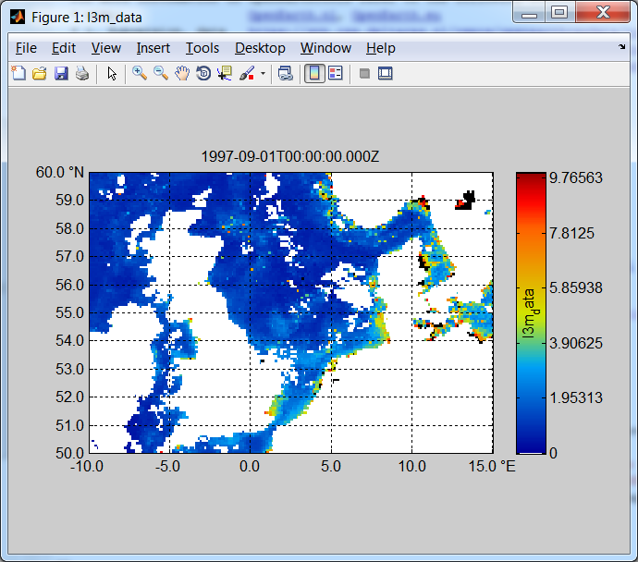
2. WMS: with Matlab (OET)

Slide 17
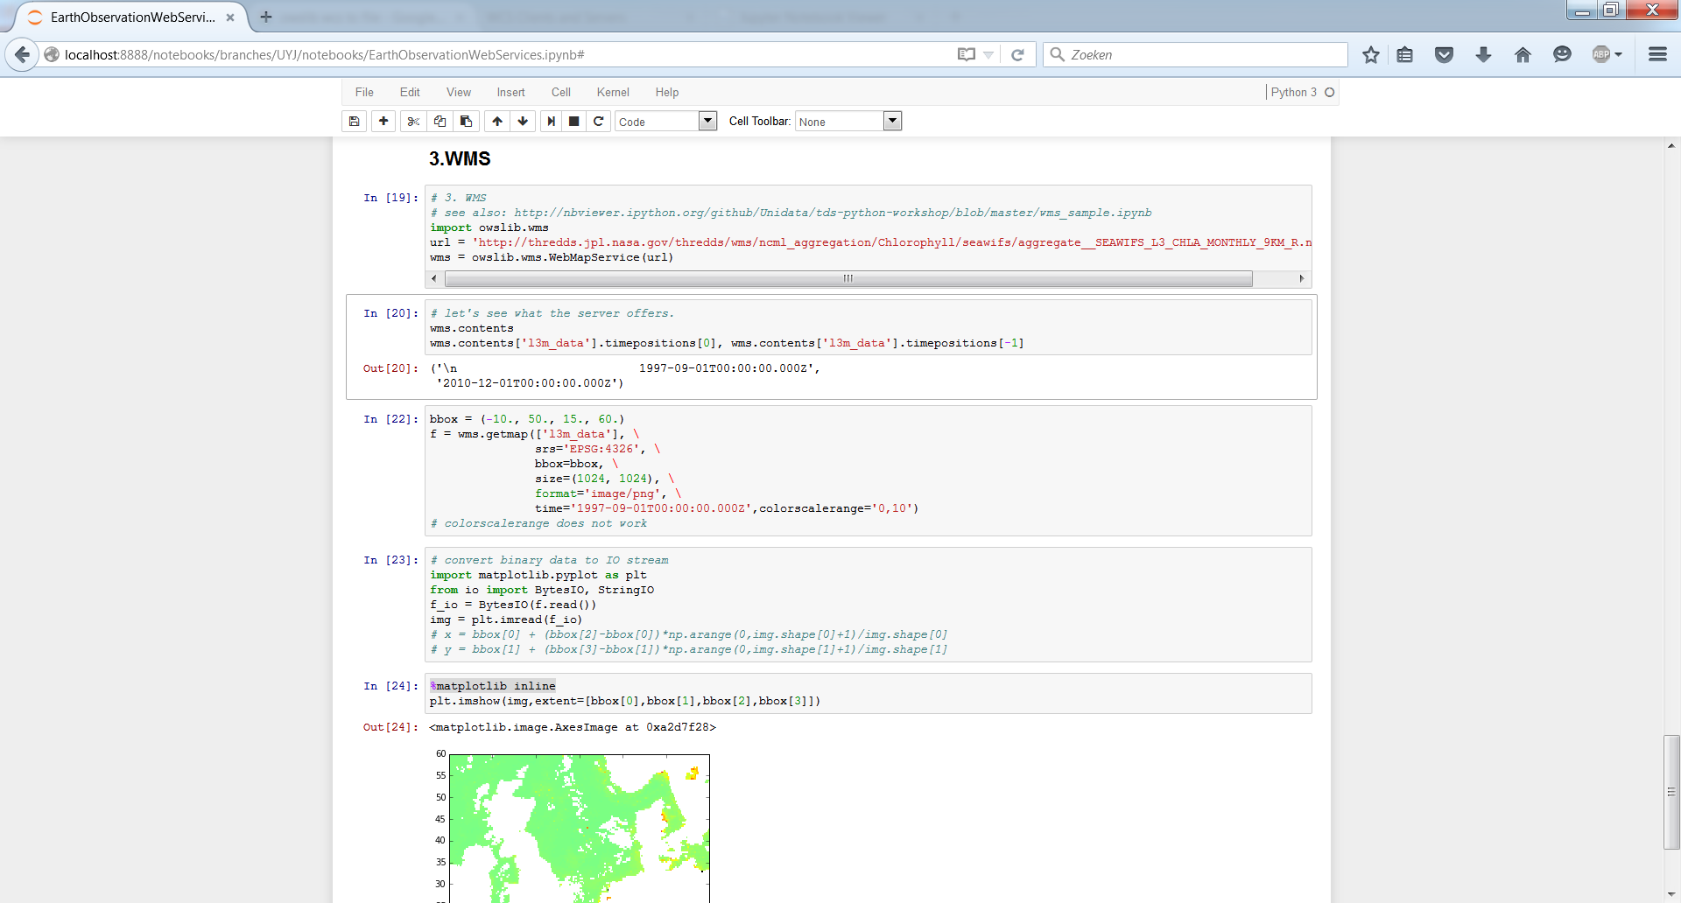
2. WMS: with Python

Slide 18
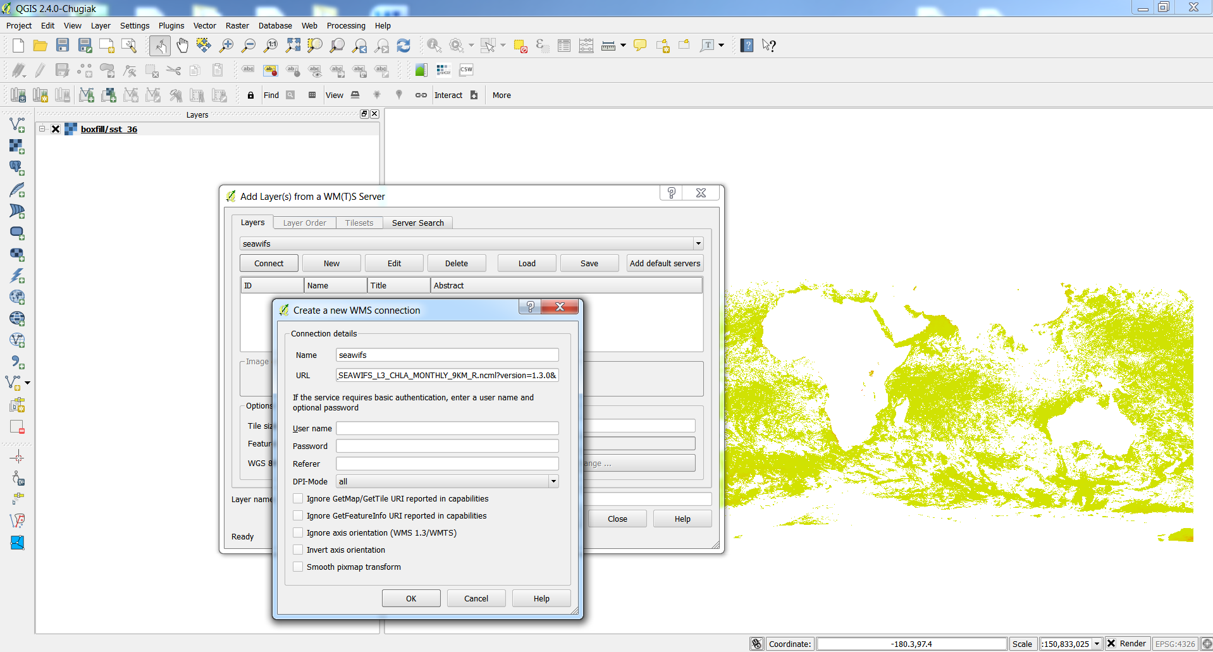
2. WMS: with QGIS
CANNOT add non OGC keywords like colorscalerange

Slide 19
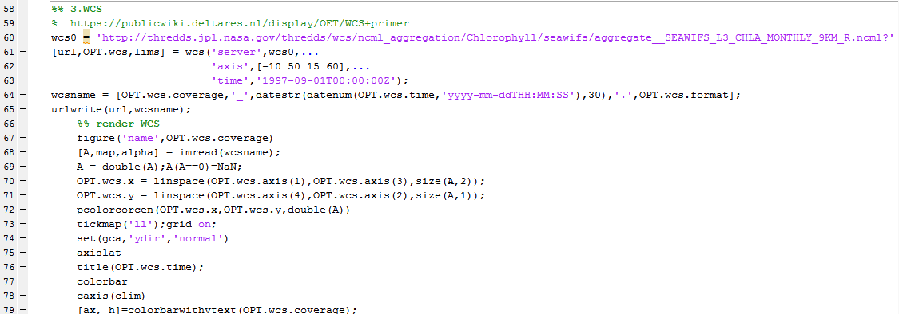
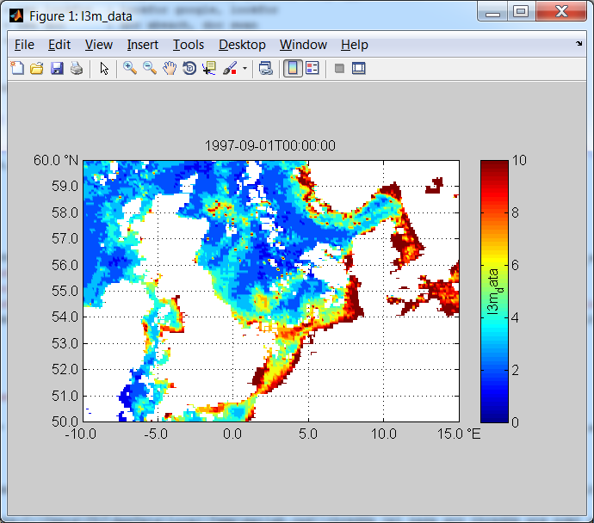
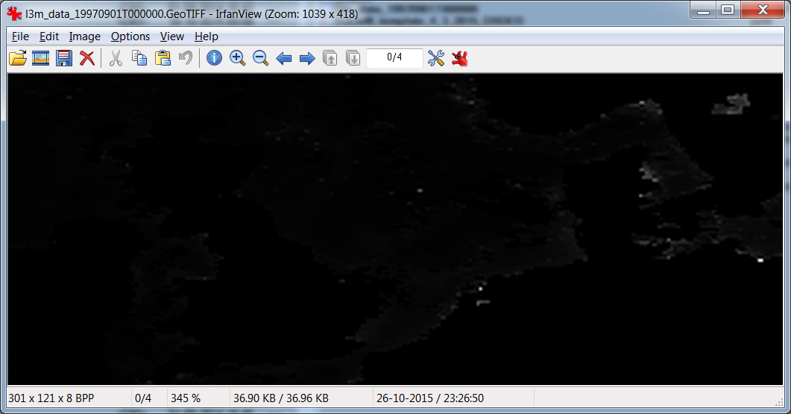
3. WCS: with Matlab
WCS takes geographical bbox, unlike netCDF-OPeNDAP

Slide 20
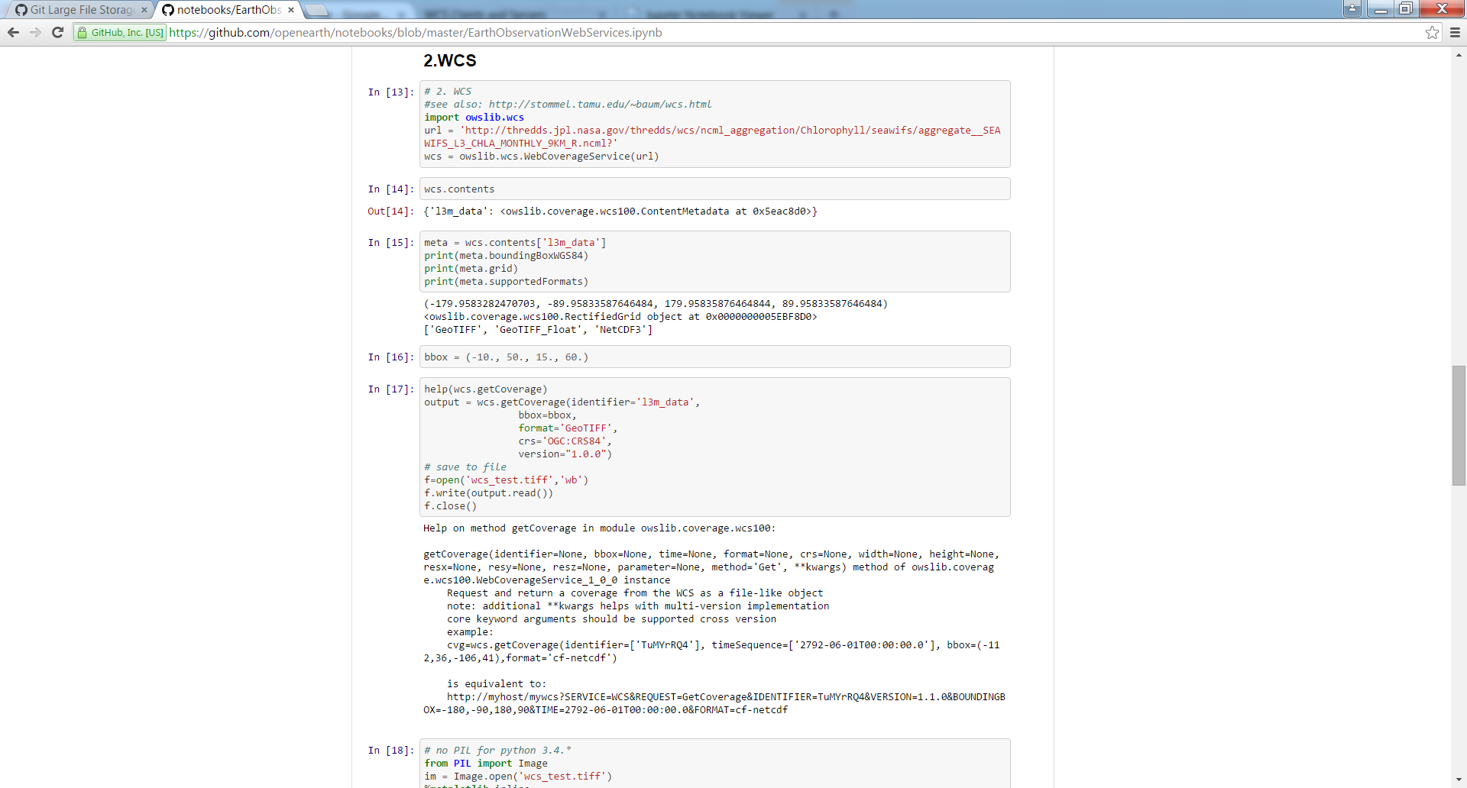
3. WCS: with Python
WCS takes geographical bbox, unlike netCDF-OPeNDAP

Slide 21
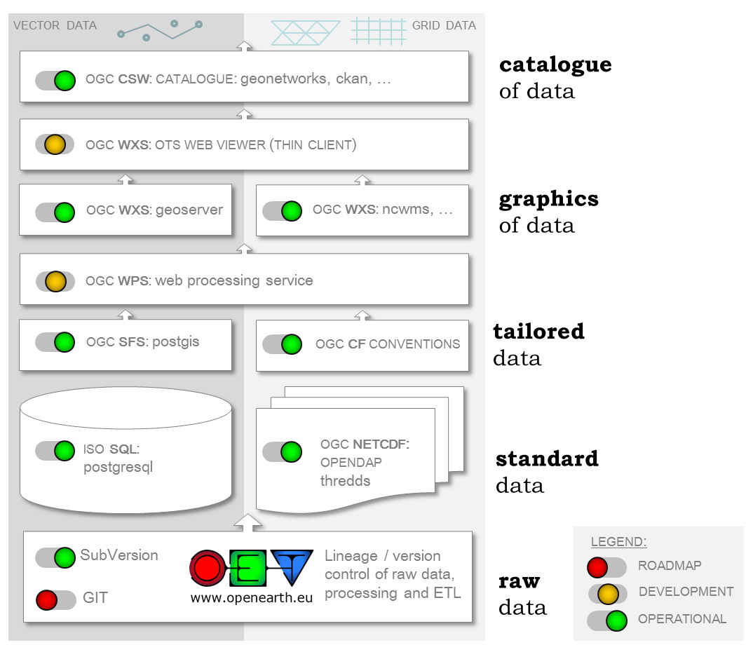
OpenEarth server stack:
serve your own data too !

